Slide 1



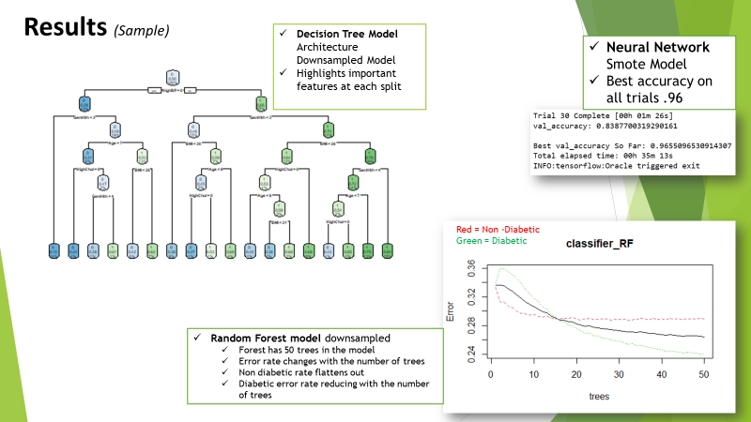
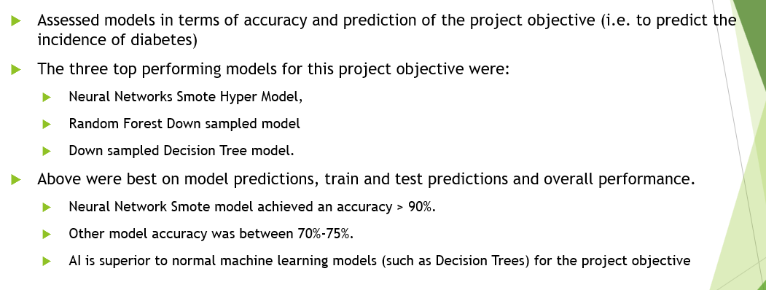
An analysis of the causes and prevention of diabetes
Benjamin Kelly, BSc. Honours in Data Science
PROJECT AIM: Determine which classification model is best for predicting someone being diabetic by using suitable data analysis to understand the links between lifestyle data features and the incidence of diabetes.
Technology
Power BI – Visualisations , Correlations and Patterns
Jupyter – Python and Neural Networks Implementation
R Studio – Statistical Analysis and Classification Model Implementation
“Given relevant data and the application of classifiers on that data, what is the likelihood of someone being diagnosed as a diabetic?”.
Datasets
10 Years Diabetes Dataset (Kaggle)
Diabetes Health Indicators Dataset (Kaggle)
Data Analysis and Preparation
Visualisation Analysis: PowerBI
Statistical Analysis : Correlation analysis / Histogram / Mean + standard deviation analysis / Frequency analysis /Pearson Chi-Squared test / Student T Tests / Non-parametric tests /Cohens Kappa Score / Imputation
Preparation: Replacing values / Creating data subsets / Merging data frames / One-Hot encoding and Encoding values
Modelling
Models: Random Forest / Decision trees / Naïve Bayes and Neural Networks
Dataset approach: Regular Splitting/Data Subsets/ Down Sample and Smote
Activities and Results
Activities: Splitting the data / Train and test / Checking proportions / Factoring variables /Fitting data / Collecting predictions / Confusion matrix / Plot models
Tools: Network models / Hypermodel / tensorflow / tensorflow.keras.layers / keras_tuner
Results Top models 1) Neural Networks Smote Hyper Model 2) Random Forest Down sampled model 3) Down sampled Decision Tree model.

